Slide 1

Popularity Bias in Recommender Systems
MSc Fundamental Principles Of Data Science · Lorenzo Vigo · Paula Gómez Duran
13th July 2022 · 1

Slide 2
Contents
Recommender Systems and Popularity Bias
· 2

Slide 3
Contents
Recommender Systems and Popularity Bias
Introduction and general concepts
Motivations: negative effects of popularity bias
· 2

Slide 4
Contents
Recommender Systems and Popularity Bias
Introduction and general concepts
Motivations: negative effects of popularity bias
Dataset Analysis for Popularity Bias Identification
· 2

Slide 5
Contents
Recommender Systems and Popularity Bias
Introduction and general concepts
Motivations: negative effects of popularity bias
Dataset Analysis for Popularity Bias Identification
Interaction dataset characterization
Metric definition for popularity bias in the interaction dataset
Popularity bias aggravation by Collaborative Filtering Recommender Systems
Popularity drift
· 2

Slide 6
Contents
Recommender Systems and Popularity Bias
Introduction and general concepts
Motivations: negative effects of popularity bias
Dataset Analysis for Popularity Bias Identification
Interaction dataset characterization
Metric definition for popularity bias in the interaction dataset
Popularity bias aggravation by Collaborative Filtering Recommender Systems
Popularity drift
State of the Art: Popularity Bias Mitigation and Leveraging
· 2

Slide 7
Recommender Systems and Popularity Bias
· 3

Slide 8
Recommender Systems
Pablo
Irina
John
Markus
Karen
Jordan
Sofia
Ada
Czeslaw
López
Kournikova
Smith
Erikson
Schmidt
Carter
Dobromir
Okeke
Novotný
M
F
M
M
F
M
F
F
M
32
26
17
45
52
25
41
34
57
Spain
Ukraine
UK
Sweden
Germany
USA
Hungary
Nigeria
Czech R.
· 4

Slide 9
Recommender Systems
Users
· 4

Slide 10



Recommender Systems
Users
Action · 2022
Animation · 2022
Comedy · 2022
· 5

Slide 11
Recommender Systems
Users
Movies
· 5

Slide 12
Recommender Systems
Users
Lin watched Top Gun: Maverick
Karen visited Lightyear details page
Czeslaw visited Paper Girls details page
John reviewed Morbius with a 10
Jordan disliked The Terminal
Markus reviewed The Black Phone with a 4
Mohammed watched Elvis
Ada reviewed Benediction with a 7
Irina ignored her recommendations
Movies
· 6

Slide 13
Recommender Systems
Users
Movies
Interactions
· 6

Slide 14
Recommender Systems
Users
Recommender
System
Movies
Interactions
· #

Slide 15
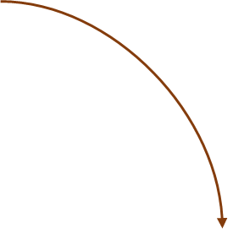
Recommender Systems
Users
Recommender
System
Movies
Interactions
· 7

Slide 16

Recommender Systems
Users
Recommender
System
Recommendations
Movies
Pablo should watch
Interactions
· 7

Slide 17
Recommender Systems
Users
Recommender
System
Recommendations
Movies
Pablo should watch
Cold-Start Problem
Interactions
· 8

Slide 18

Recommender Systems
Users
Inaccurate
Recommender
System
Recommendations
Movies
Pablo should watch
Cold-Start Problem
Interactions
· 8

Slide 19
Popularity Bias
Long Tail Distribution
popularity
items ranked by popularity
· 9

Slide 20
Popularity Bias
Long Tail Distribution
popularity
short head
items ranked by popularity
· 9

Slide 21
Popularity Bias
Long Tail Distribution
popularity
short head
long tail
items ranked by popularity
· 9

Slide 22
Popularity Bias
Long Tail Distribution
popularity
short head
long tail
distant tail
items ranked by popularity
· 9

Slide 23
Popularity Bias
In general, Recommender Systems sharpen this distribution in their recommendations. This effect is known as Popularity Bias.
popularity
items ranked by popularity
· 10

Slide 24
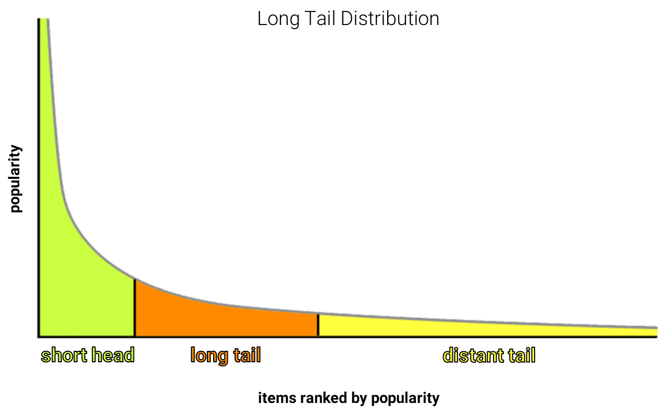
Negative impact of Popularity Bias
Matthew Effect
· 11

Slide 25
Negative impact of Popularity Bias
Matthew Effect
Long tail items do not have enough exposure.
· 11

Slide 26
Negative impact of Popularity Bias
Matthew Effect
Long tail items do not have enough exposure.
Low diversity recommendations.
· 11

Slide 27
Negative impact of Popularity Bias
Matthew Effect
Long tail items do not have enough exposure.
Low diversity recommendations.
Recommending popular items hinders item discovery.
· 11

Slide 28
Negative impact of Popularity Bias
Matthew Effect
Long tail items do not have enough exposure.
Low diversity recommendations.
Recommending popular items hinders item discovery.
Promoting a herd mentality within the users.
· 11

Slide 29
Negative impact of Popularity Bias
Matthew Effect
Long tail items do not have enough exposure.
Low diversity recommendations.
Recommending popular items hinders item discovery.
Promoting a herd mentality within the users.
Echo Chambers and Filter Bubbles
· 12

Slide 30
Negative impact of Popularity Bias
Matthew Effect
Long tail items do not have enough exposure.
Low diversity recommendations.
Recommending popular items hinders item discovery.
Promoting a herd mentality within the users.
Echo Chambers and Filter Bubbles
Echo chambers: generation of social communities who share similar opinions within the group.
· 12

Slide 31
Negative impact of Popularity Bias
Matthew Effect
Long tail items do not have enough exposure.
Low diversity recommendations.
Recommending popular items hinders item discovery.
Promoting a herd mentality within the users.
Echo Chambers and Filter Bubbles
Echo chambers: generation of social communities who share similar opinions within the group.
Filter Bubbles: an overly narrow set of recommenders isolating users in information echo chambers.
· 12

Slide 32
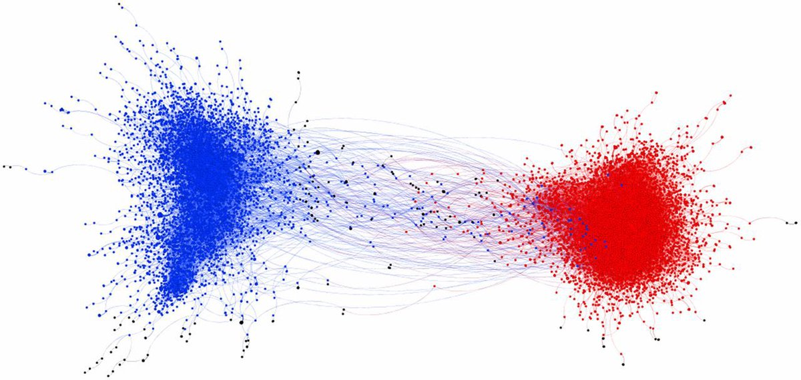
Echo Chambers and Filter Bubbles
Recommender Systems influence on user tastes, interests and beliefs.
Confirmation bias: reinforcement due to repeated exposure to similar opinions or items.
Other approaches may incur in conflict with Freedom of Thought and Speech.
· 13

Slide 33
Dataset Analysis for Popularity Bias Identification
· 14

Slide 34

Dataset: MovieLens-1M
Over 6000 users.
Over 4000 movies.
Real interactions.
· 15

Slide 35
Dataset: MovieLens-1M
Over 6000 users.
Over 4000 movies.
Real interactions.
Preprocessing: getting rid of distant tail entities.
· 15

Slide 36
Dataset: MovieLens-1M
Over 6000 users.
Over 4000 movies.
Real interactions.
Preprocessing: getting rid of distant tail entities.
Time-Aware Leave One Out strategy.
· #

Slide 37
Dataset: MovieLens-1M
Over 6000 users.
Over 4000 movies.
Real interactions.
Preprocessing: getting rid of distant tail entities.
Time-Aware Leave One Out strategy.
Users can not be recommended items they have already interacted with.
· 15

Slide 38
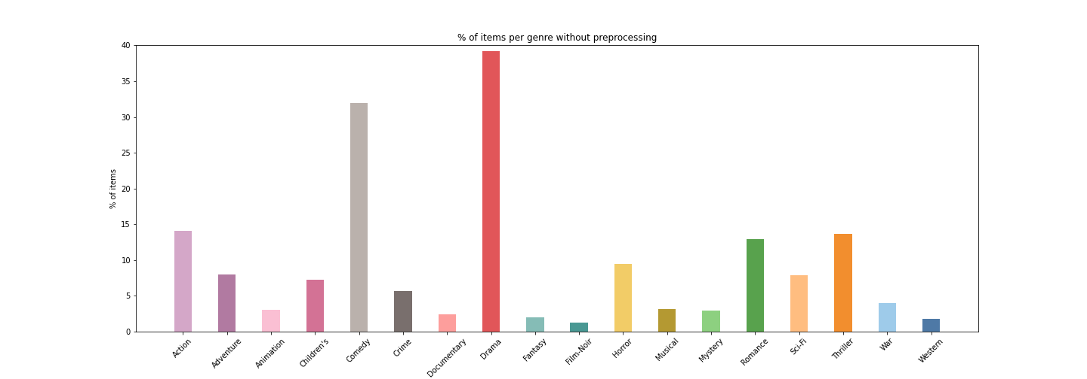
Dataset: MovieLens-1M
· 16

Slide 39
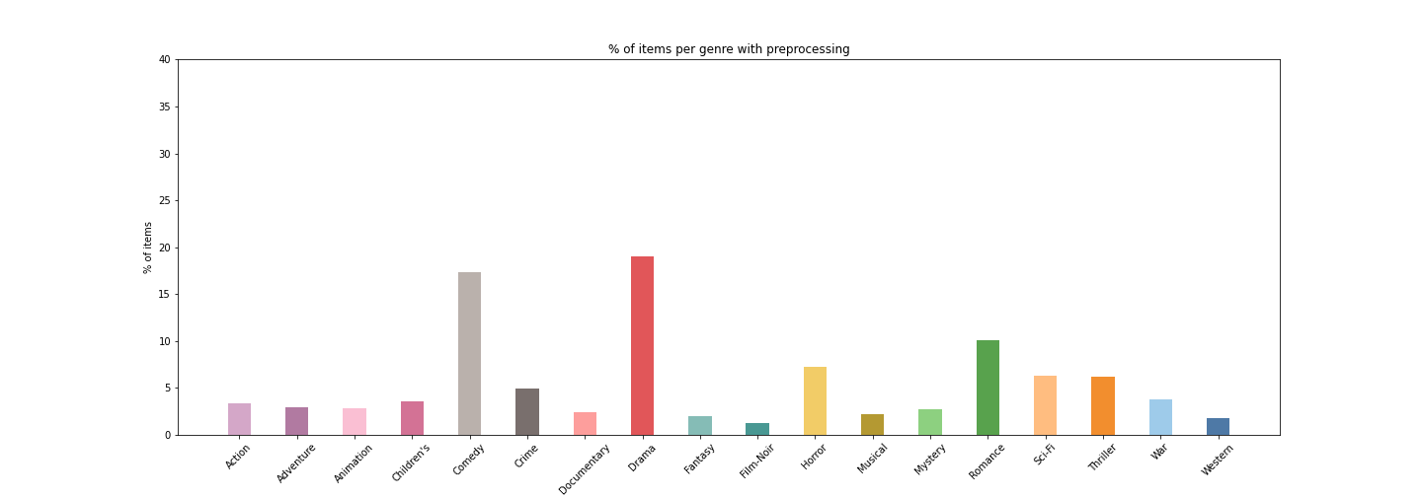
Dataset: MovieLens-1M
· 17

Slide 40
Random Recommender
If users were completely unbiased and irrational, they would choose the items they interact with by random.
· 18

Slide 41
Random Recommender
If users were completely unbiased and irrational, they would choose the items they interact with by random.
The previous assumption is portrayed in the Random model’s recommendations.
· 18

Slide 42
Random Recommender
If users were completely unbiased and irrational, they would choose the items they interact with by random.
The previous assumption is portrayed in the Random model’s recommendations.
Therefore, the Random Recommender is unbiased in terms of item popularity.
· 18

Slide 43
Random Recommender
· 19

Slide 44
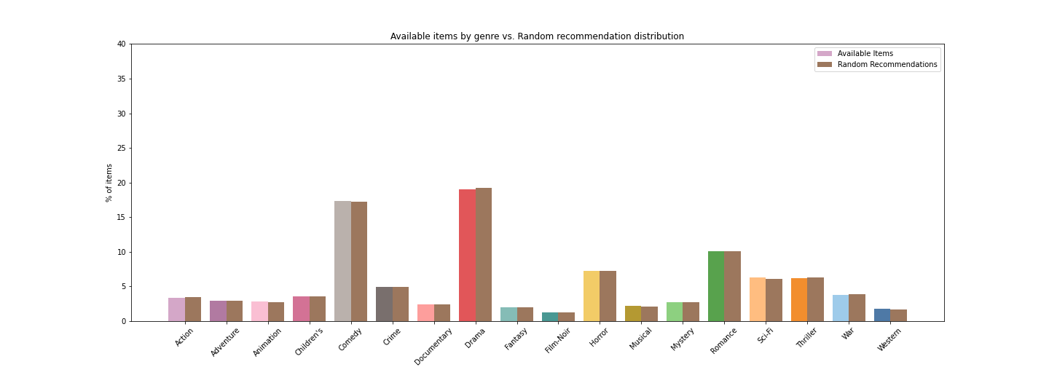
Random Recommender
· 20

Slide 45
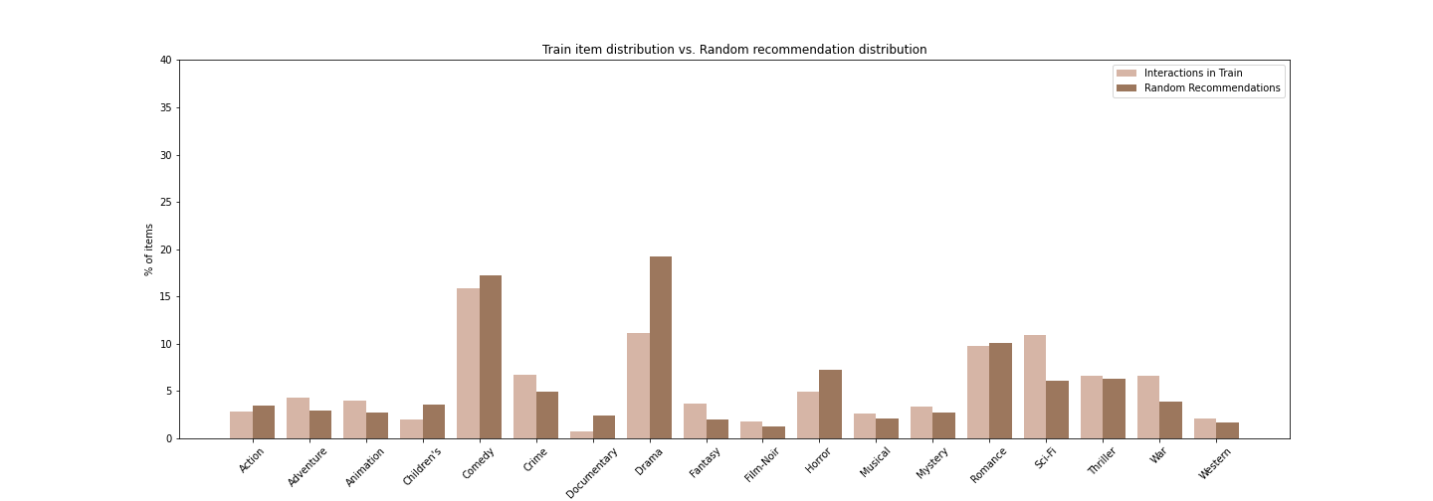
Interaction Dataset Characterization
· 21

Slide 46
Interaction Dataset Characterization
· 22

Slide 47
Interaction Dataset Characterization
The difference in the distributions is a univocal characterization of our interaction dataset.
· 22

Slide 48
Interaction Dataset Characterization
The difference in the distributions is a univocal characterization of our interaction dataset.
We can conclude that the users are not random.
· 22

Slide 49
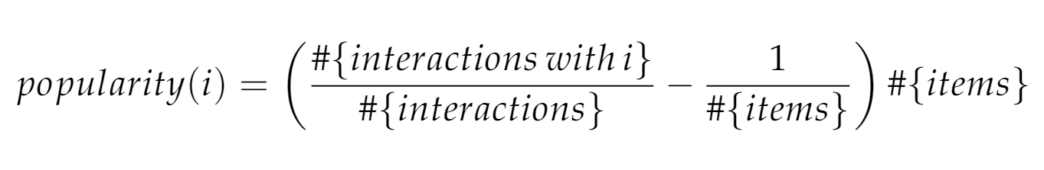
Interaction Dataset Characterization
· 23

Slide 50
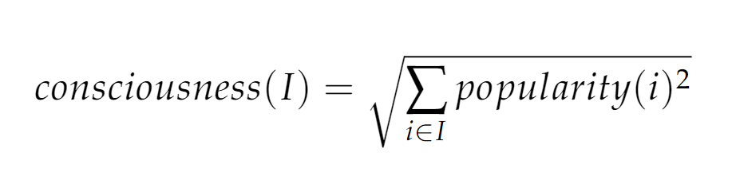
Interaction Dataset Characterization
· 23

Slide 51
Consciousness of a Community
The consciousness describes how distant the users are from acting fully randomly.
· 24

Slide 52
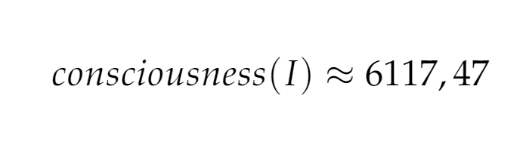
Consciousness of a Community
The consciousness describes how distant the users are from acting fully randomly.
· 24

Slide 53
Itempop
· 25

Slide 54
Itempop
Itempop recommends the most popular items to all the users.
· 25

Slide 55
Itempop
Itempop recommends the most popular items to all the users.
The recommendations directly inherit the popularity of the items.
· 25

Slide 56
Itempop
Itempop recommends the most popular items to all the users.
The recommendations directly inherit the popularity of the items.
It is trivial that Itempop is a popularity biased Recommender System.
· 25

Slide 57
Itempop
Itempop recommends the most popular items to all the users.
The recommendations directly inherit the popularity of the items.
It is expected to be the most popularity biased Recommender System.
· 25

Slide 58
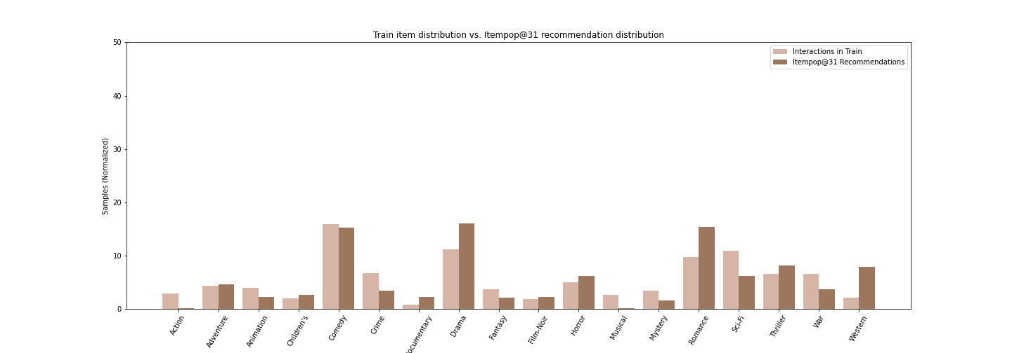
Popularity Bias in Itempop
· 26

Slide 59
Bias Effect: popularity bias identification
Aggregated Genre Popularity:
· 27

Slide 60
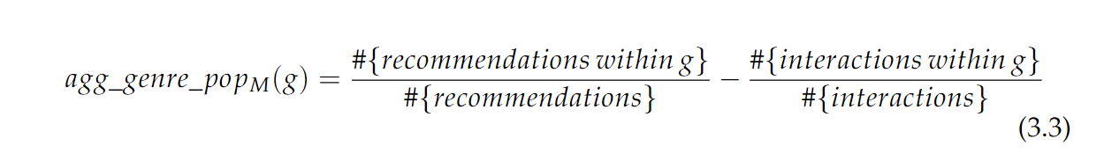
Bias Effect: popularity bias identification
Aggregated Genre Popularity:
· 27

Slide 61
Bias Effect: popularity bias identification
Aggregated Genre Popularity:
Bias Effect: reflects how well a model handles popularity bias
· 27

Slide 62
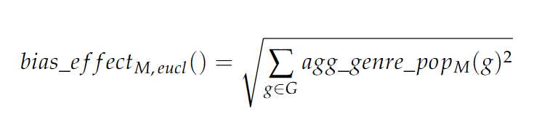
Bias Effect: popularity bias identification
Aggregated Genre Popularity:
Bias Effect: reflects how well a model handles popularity bias
· 27

Slide 63
Bias Effect: popularity bias identification
Bias Effect: reflects how well a model handles popularity bias
· 28

Slide 64
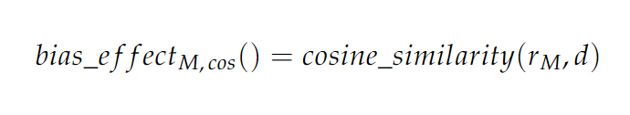
Bias Effect: popularity bias identification
Bias Effect: reflects how well a model handles popularity bias
· 28

Slide 65
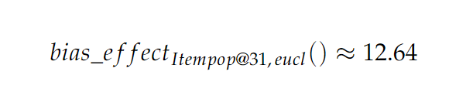
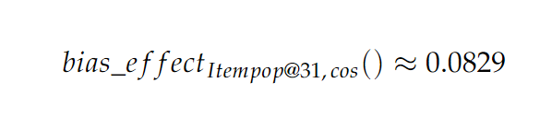
Popularity Bias in Itempop
· 31

Slide 66
Popularity Bias in Itempop
· 32

Slide 67
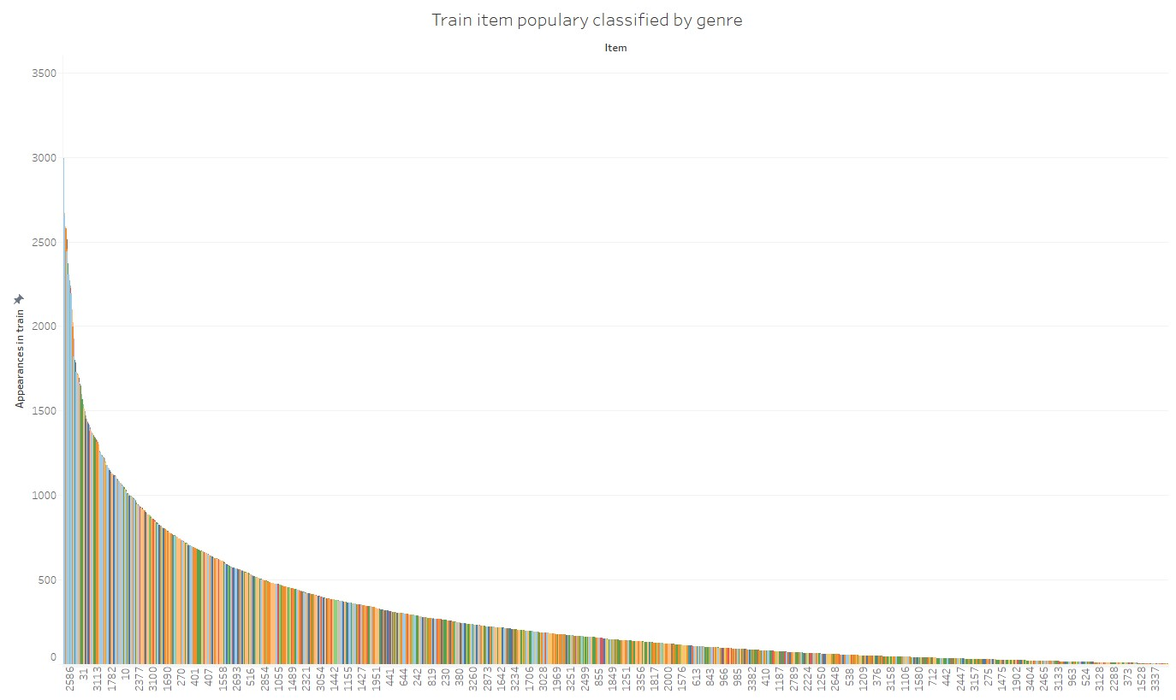
· 33

Slide 68
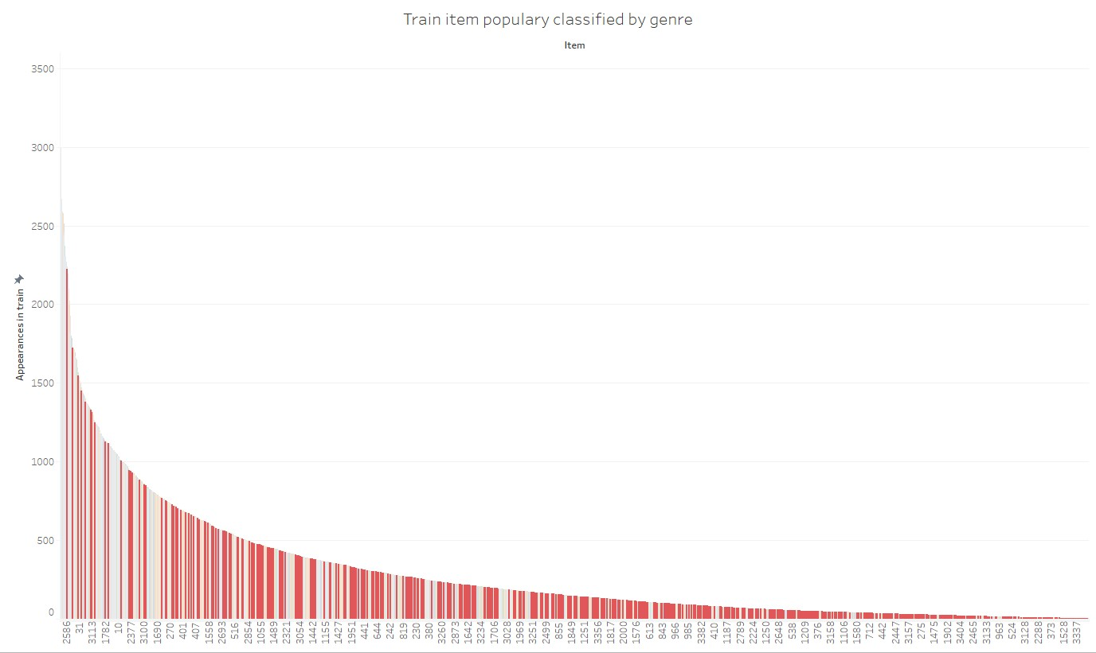
drama items
· 34

Slide 69
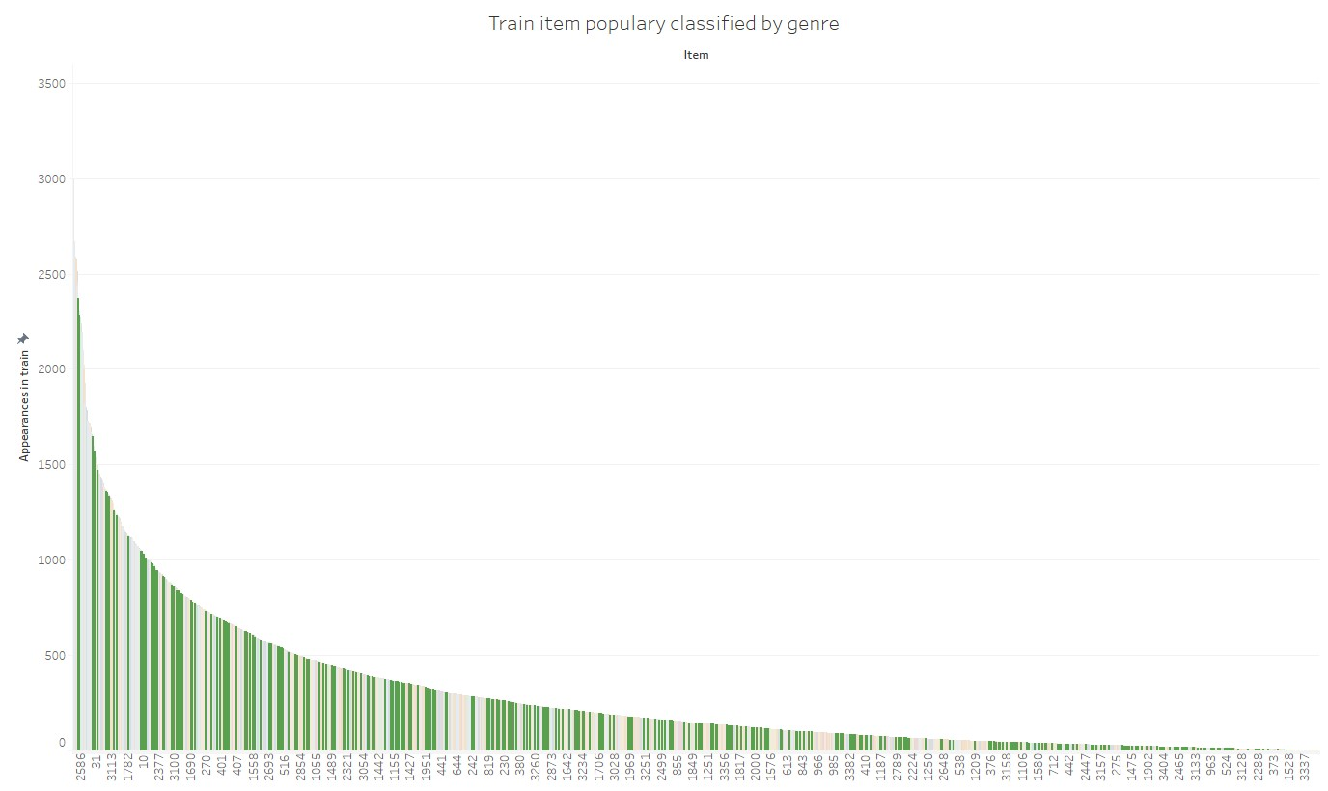
romance items
· 35

Slide 70
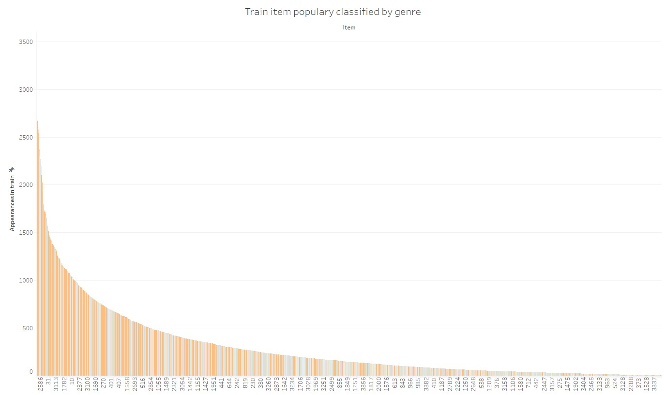
sci-fi items
· 36

Slide 71
· 37

Slide 72
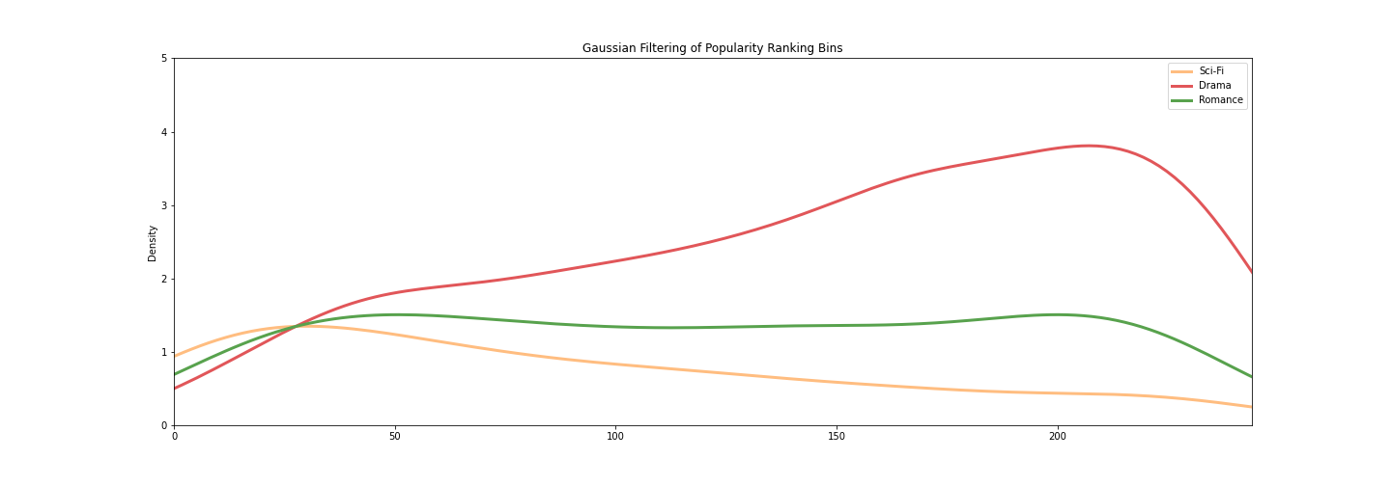
Popularity Bias in Itempop
· 38

Slide 73
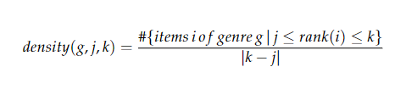
Popularity Bias in Itempop
· 38

Slide 74
Bias Aggravation by Collaborative Filtering Recommender Systems
· 40

Slide 75
Bias Aggravation by Collaborative Filtering Recommender Systems
Factorization Machine: Recommender System that models the strength of each attribute of the interactions and the strength of the relationship between attributes.
· 40

Slide 76
Bias Aggravation by Collaborative Filtering Recommender Systems
Factorization Machine: Recommender System that models the strength of each attribute of the interactions and the strength of the relationship between attributes.
Factorization Machine with Graph Convolutional Embedding: Enriched version of Factorization Machines that uses a Graph Convolutional Network instead of a regular embedding.
· 40

Slide 77
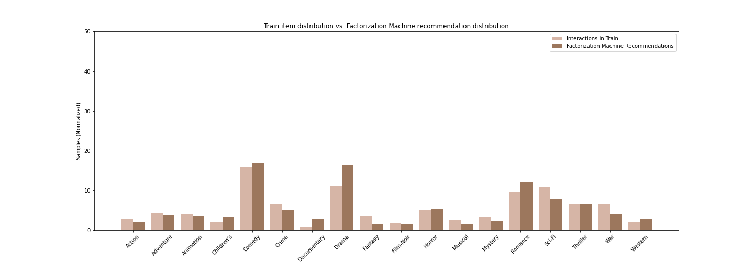
Bias Aggravation by Collaborative Filtering Recommender Systems
Factorization Machine
· 41

Slide 78
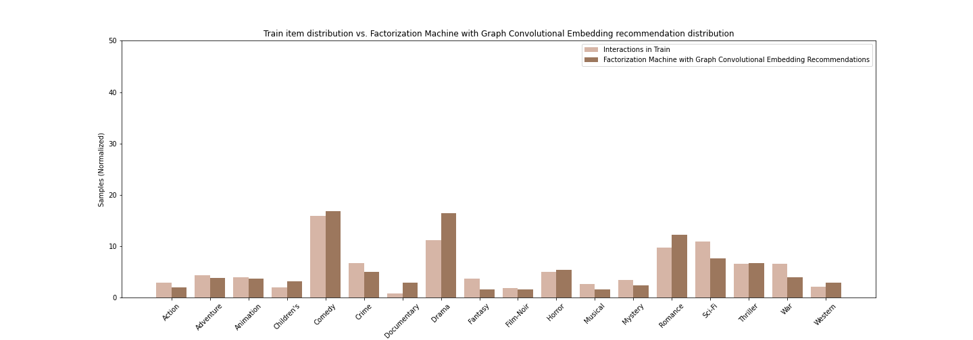
Bias Aggravation by Collaborative Filtering Recommender Systems
Factorization Machine with Graph Convolutional Embeddings
· 42

Slide 79
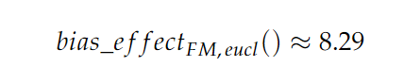
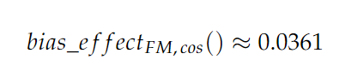
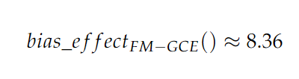
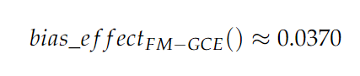
Bias Effects for all Models
Itempop:
Factorization Machine:
Factorization Machine with Graph Convolutional Embeddings:
· 43

Slide 80
Popularity Drift
· 44

Slide 81
Popularity Drift
It is intuitive to think that item popularity is dynamic and changes over time.
· 44

Slide 82
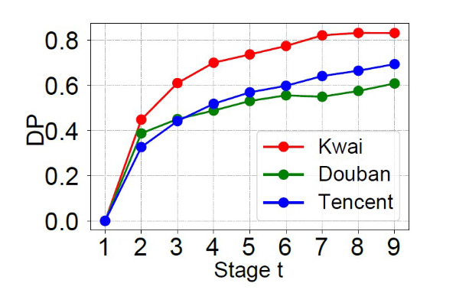
Popularity Drift
It is intuitive to think that item popularity is dynamic and changes over time.
Drift of Popularity measures the change of item popularities between two periods of time in our dataset.
· 44

Slide 83
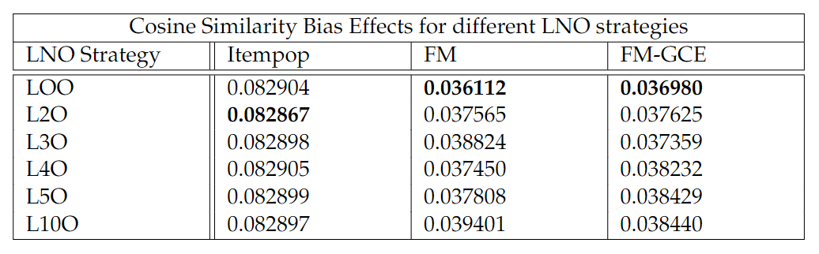
Popularity Bias and Popularity Drift
· 45

Slide 84
Results
· 46

Slide 85
Results
Hit Ratio (HR): Computes the ratio of true samples among the top k recommendations for each user. Accuracy.
· 46

Slide 86
Results
Hit Ratio (HR): Computes the ratio of true samples among the top k recommendations for each user. Accuracy.
Normalized Discounted Cumulative Gain (NDCG): Evaluates the positions in which the test samples are included in the top k recommendations for each user. Ranking quality.
· 46

Slide 87
Results
Hit Ratio (HR): Computes the ratio of true samples among the top k recommendations for each user. Accuracy.
Normalized Discounted Cumulative Gain (NDCG): Evaluates the positions in which the test samples are included in the top k recommendations for each user. Ranking quality.
Coverage: Analyses the diversity among recommended items.
· 46

Slide 88
Results
Hit Ratio (HR): Computes the ratio of true samples among the top k recommendations for each user. Accuracy.
Normalized Discounted Cumulative Gain (NDCG): Evaluates the positions in which the test samples are included in the top k recommendations for each user. Ranking quality.
Coverage: Analyses the diversity among recommended items.
Inverse Propensity Score (IPS): Describes the popularity of the items that are recommended.
· 46

Slide 89
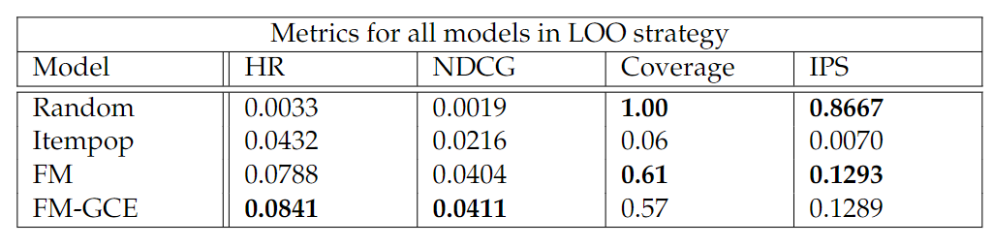
Results
· 47

Slide 90
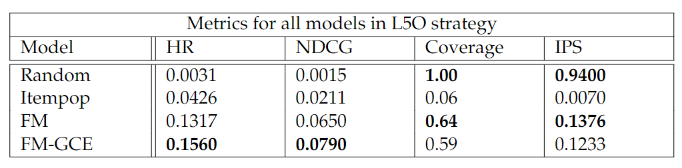
Results
· 48

Slide 91
Results
Factorization Machine is the most popularity aware Recommender System out of the tested models.
· 49

Slide 92
Results
Factorization Machine is the most popularity aware Recommender System out of the tested models.
Consistent with the analysis done through the Bias Effect metric.
· 49

Slide 93
Results
Factorization Machine is the most popularity aware Recommender System out of the tested models.
Consistent with the analysis done through the Bias Effect metric.
Factorization Machine with Graph Convolutional Embeddings achieves better recommendations in terms of accuracy and ranking quality, without worsening the bias effect too much.
· 49

Slide 94
Results
Factorization Machine is the most popularity aware Recommender System out of the tested models.
Consistent with the analysis done through the Bias Effect metric.
Factorization Machine with Graph Convolutional Embeddings achieves better recommendations in terms of accuracy and ranking quality, without worsening the bias effect too much.
Expected trade-off between accuracy and recommending unpopular items.
· 49

Slide 95
Popularity Bias Mitigation and Leveraging
· 50

Slide 96
Inverse Propensity Scoring (IPS)
Giving those samples involving popular items a lower weight to compensate the long tail distribution in the dataset.
· 51

Slide 97
Inverse Propensity Scoring (IPS)
Costly computation of the true propensity scores.
· 52

Slide 98
Inverse Propensity Scoring (IPS)
Costly computation of the true propensity scores.
Approaches that compute adequate approximations.
· 52

Slide 99
Inverse Propensity Scoring (IPS)
Costly computation of the true propensity scores.
Approaches that compute adequate approximations.
IPS presents a high variance problem.
· 52

Slide 100
Causal Embedding
Use bias-free data to get the model to learn an unbiased embedding.
· 53

Slide 101
Causal Embedding
Use bias-free data to get the model to learn an unbiased embedding.
Users will be shown random recommendations.
· 53

Slide 102
Ranking Adjustment
Popularity Compensation: Correction of predicted scores. Benefitting those unpopular items that match the user tastes.
· 54

Slide 103
Ranking Adjustment
Popularity Compensation: Correction of predicted scores. Benefitting those unpopular items that match the user tastes.
Explicit Query Aspect Diversification (xQuAD): Result diversification selects items that satisfy an unconvered aspect in a query.
· 54

Slide 104
Ranking Adjustment
Popularity Compensation: Correction of predicted scores. Benefitting those unpopular items that match the user tastes.
Explicit Query Aspect Diversification (xQuAD): Result diversification selects items that satisfy an unconvered aspect in a query.
short head
short head
short head
short head
· 54

Slide 105
Ranking Adjustment
Popularity Compensation: Correction of predicted scores. Benefitting those unpopular items that match the user tastes.
Explicit Query Aspect Diversification (xQuAD): Result diversification selects items that satisfy an unconvered aspect in a query.
short head
short head
short head
short head
short head
long tail
· 54

Slide 106
Ranking Adjustment
Popularity Compensation: Correction of predicted scores. Benefitting those unpopular items that match the user tastes.
Explicit Query Aspect Diversification (xQuAD): Result diversification selects items that satisfy an unconvered aspect in a query.
short head
short head
short head
short head
long tail
· 54

Slide 107
Causal Intervention
Leverage the popularity bias instead of eliminating it.
· 55

Slide 108
Causal Intervention
Leverage the popularity bias instead of eliminating it.
Analysis in a casual graph: item popularity is a confounder.
· 55

Slide 109
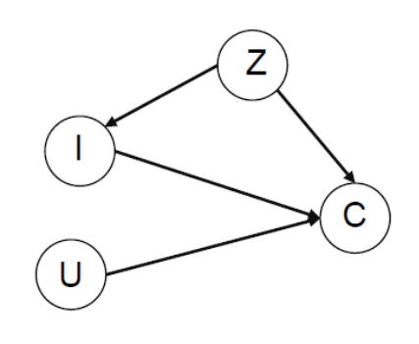
Causal Intervention
Leverage the popularity bias instead of eliminating it.
Analysis in a casual graph: item popularity is a confounder.
· 55

Slide 110
Causal Intervention
Leverage the popularity bias instead of eliminating it.
Analysis in a casual graph: item popularity is a confounder.
Do-calculus: allows us to intervene in the casual graph and delete only the negative effects of popularity.
· 55

Slide 111
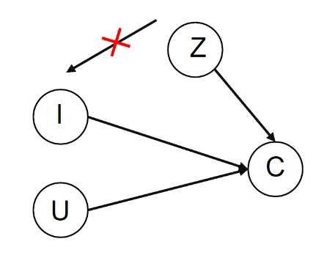
Causal Intervention
Leverage the popularity bias instead of eliminating it.
Analysis in a casual graph: item popularity is a confounder.
Do-calculus: allows us to intervene in the casual graph and delete only the negative effects of popularity.
· 56

Slide 112
Future Work
· 57

Slide 113
Future Work
Applying the bias mitigation and leveraging techniques and check their impact by comparing the bias effect.
· 57

Slide 114
Future Work
Applying the bias mitigation and leveraging techniques and check their impact by comparing the bias effect.
Extend our analysis to further distance and similarity functions.
· 57

Slide 115
Future Work
Applying the bias mitigation and leveraging techniques and check their impact by comparing the bias effect.
Extend our analysis to further distance and similarity functions.
Compare more models and perform the experiment in other datasets.
· 57

Slide 116
Future Work
Applying the bias mitigation and leveraging techniques and check their impact by comparing the bias effect.
Extend our analysis to further distance and similarity functions.
Compare more models and perform the experiment in other datasets.
Repeat and improve the popularity drift analysis.
· 57

Slide 117
Conclusions
· 58

Slide 118
Conclusions
· 59

Slide 119
Conclusions
Introduction of Recommender Systems and Popularity Bias.
· 59

Slide 120
Conclusions
Introduction of Recommender Systems and Popularity Bias.
Explain the importance of handling the Popularity Bias:
Matthew Effect
Echo Chambers
Filter Bubbles
· 59

Slide 121
Conclusions
Introduction of Recommender Systems and Popularity Bias.
Explain the importance of handling the Popularity Bias:
Matthew Effect
Echo Chambers
Filter Bubbles
Characterization of the interaction dataset:
Consciousness
Popularity of an item
Aggregated popularity bias
· 59

Slide 122
Conclusions
Metric definition to quantify the popularity bias aggravation: Bias Effect
Bias Effect analysis in several recommenders.
Popularity Drift and Bias Effect
· 60

Slide 123
Conclusions
Metric definition to quantify the popularity bias aggravation: Bias Effect
Bias Effect analysis in several recommenders.
Popularity Drift and Bias Effect
Factorization Machine is the best tried model to handle popularity bias.
· 60

Slide 124
Conclusions
Metric definition to quantify the popularity bias aggravation: Bias Effect
Bias Effect analysis in several recommenders.
Popularity Drift and Bias Effect
Factorization Machine is the best tried model to handle popularity bias.
Factorization Machine with Graph Convolutional Embedding has better recommendations with a little worse popularity awareness.
· 60

Slide 125
Conclusions
Introduction of bias mitigation and leveraging techniques.
Inverse Propensity Score
Causal Embeddings
Popularity Compensation
Explicit Query Aspect Diversification
Popularity-bias Deconfounding and Adjusting
· 61

Slide 126
Popularity Bias in Recommender Systems
MSc Fundamental Principles Of Data Science · Lorenzo Vigo · Paula Gómez Duran
13th July 2022 · 1

Slide 127
Section Title
· #

Slide 128
Title
· #

Slide 129
Title
· #

